Slide 2
“
Ransomware attacks are targeting organizations’ network-attached storage (NAS) and backup storage devices.
”
“
2021 will see a major emphasis in developing more comprehensive storage system security
”

Slide 3
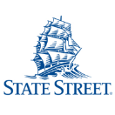
About Us
SELECTED CUSTOMERS
Founded in 2005, serving leading enterprises worldwide
We help our customers to
Prevent outages on their critical IT infrastructure
Secure their Storage & Backup environment

Slide 4
Storage Security Success Story – Leading Bank
CHALLENGE (CONTINUED)
Manual analysis is not feasible
Failure to meet auditor deadlines for remediating the gap
THE CUSTOMER
An American multinational bank and financial services company
CHALLENGE
No repeatable and trackable method to assess the security of business-critical data enterprise storage systems
Ransomware concern
SOLUTION BY CONTINUITY
Continuous scanning and analysis of the bank’s storage and backup systems worldwide
Automatic detection of security risks
Overall health and compliance reports
Low 2
Critical 14
Storage / Backup vendor
Vulnerability score
Configuration Compliance score
Medium 28
Dell EMC
Cohesity
IBM
Pure Storage
Rubrik
Hitachi Vantara
NetApp
53
39
High 9
93
100
65
22
7
71
85
52
21
96
88
35

Slide 5
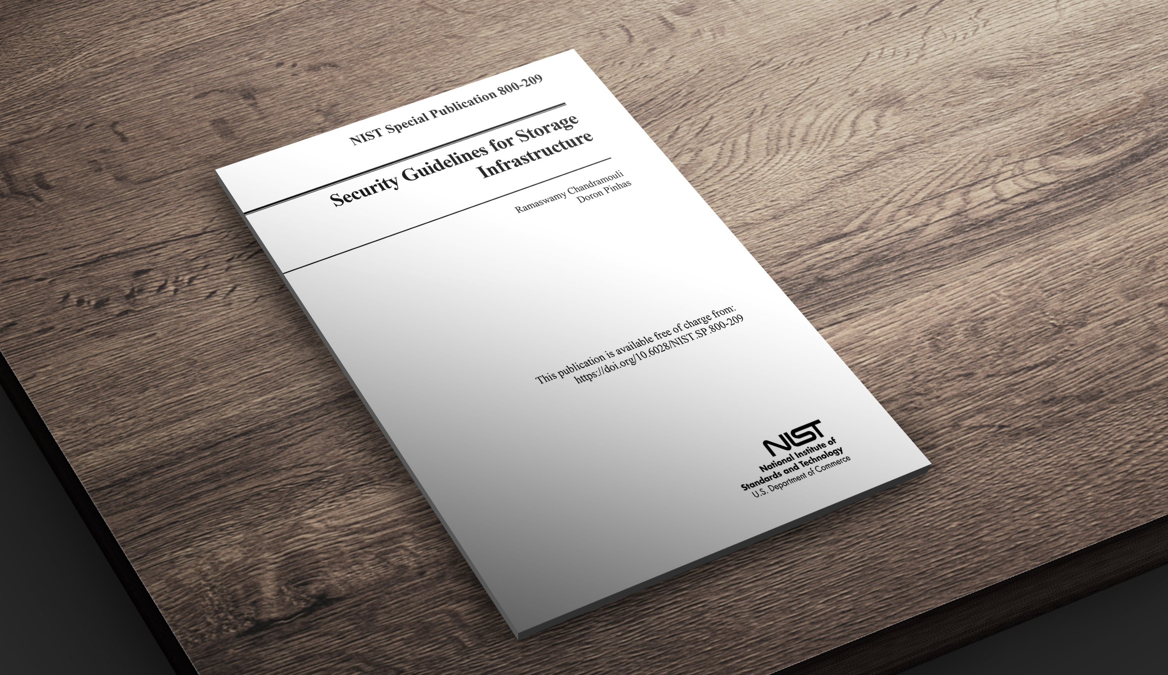
©2021 – Proprietary and Confidential Information of Continuity Software

Slide 6
Ransomware
New ransomware attacks target your NAS devices
OCIE risk alert:“Misconfigured security settings on a storage device could result in unauthorized access to information”

Slide 7
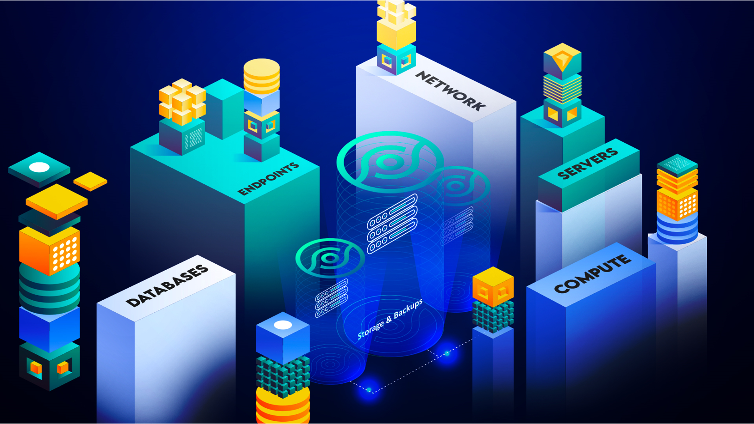
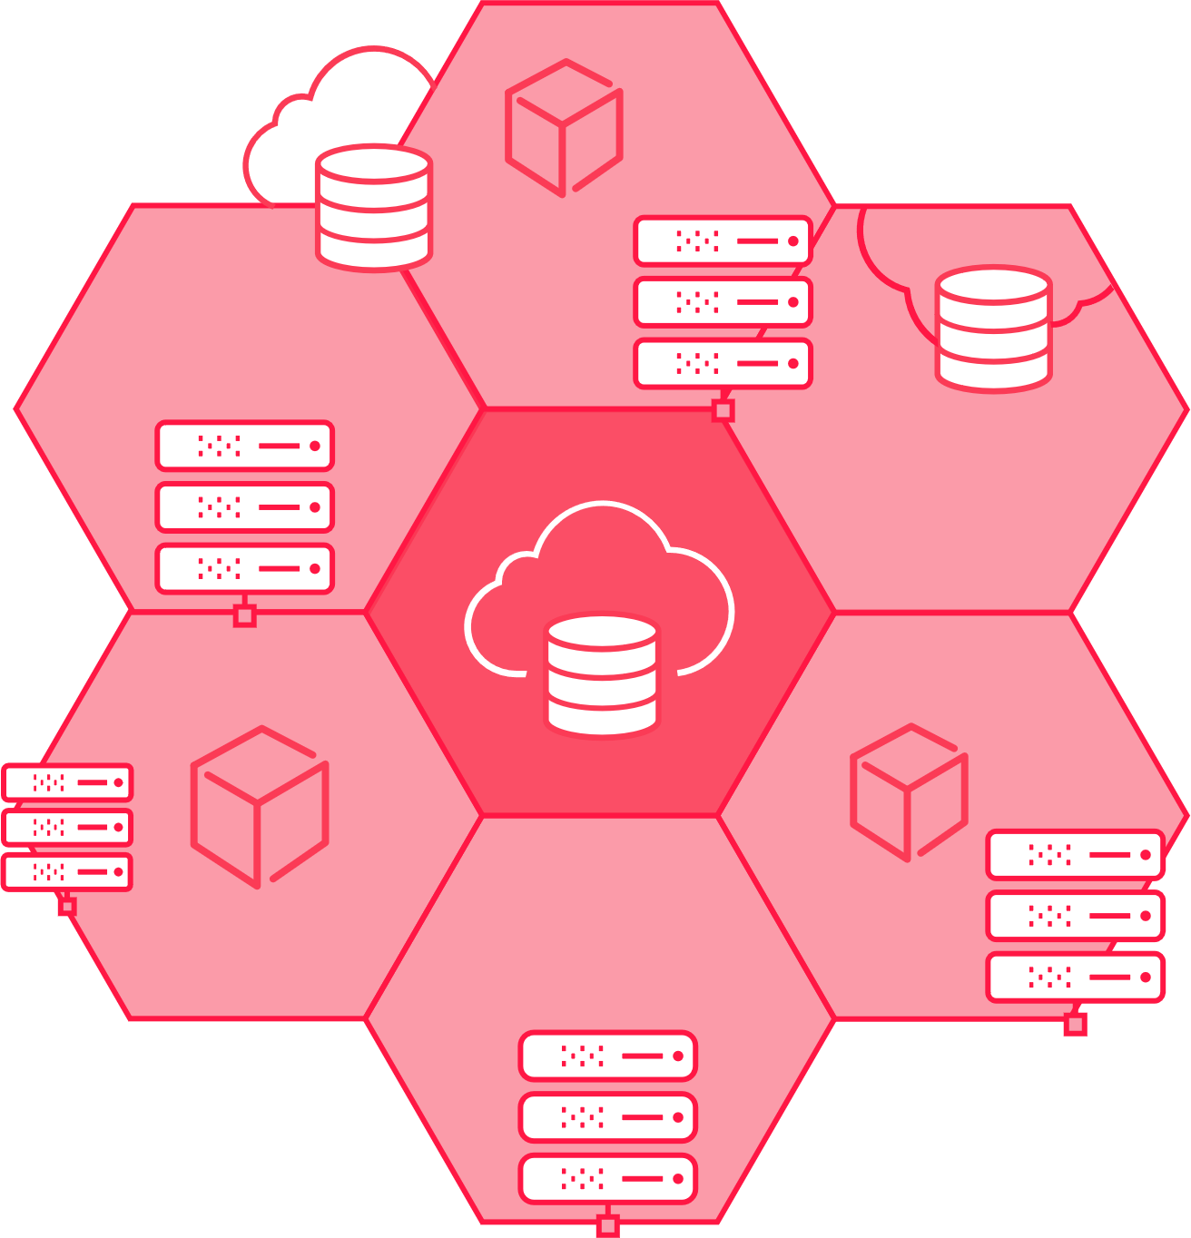
The Gap
Storage & Backup
The Ultimate Line of Defense Against Cyberattacks
Block Storage
Storage Software
Storage Management
SAN
Storage Network
Backup Systems
Object Storage
Data Protection Systems
Storage Virtualization
Server-Based Storage
File Storage

Slide 8
Is it time for more Storage & Backup Security?
New ransomware attacks target your NAS devices
 | Commonly-held Assumption | Reality
Data | Data is already secured at multiple layers (OS, Database, Network…) | Storage & Backup is where 100% of your data lives!
Attack Surface | Small and deep inside the perimeter/datacenter | Large, vulnerable, and reachable
Threat Level | Most attacks target users, end-points, servers | Number of attacks on storage is small but growing; however, impact can be devastating
Ransomware | Most ransomware encrypts data on end-points/servers; securing storage can't stop that | Storage & Backup is the last line of defense against any ransomware attack -- secure data copies & backups essential for recovery!
Existing Tools | Lots of tools already in place for vulnerability scanning (e.g., Rapid7, Nessus, Qualys) | Existing tools offer almost zero coverage for storage, storage management, and backup
OCIE risk alert:“Misconfigured security settings on a storage device could result in unauthorized access to information”

Slide 9
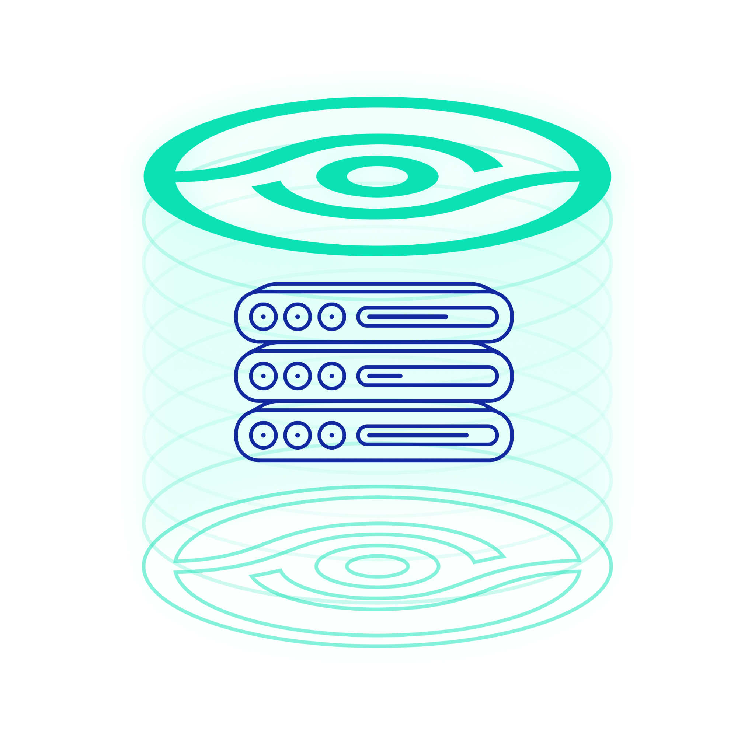
The Solution – StorageGuard
Validation of security config and (“Security Baselines”) for storage & backup systems
Built-in risk knowledgebase of security configuration best practices
Vendor best practices, community-driven baseline requirements
Ransomware protection, vulnerabilities and compliance checks
Configuration checks for Administrative Access, Authentication, Authorization, Audit Log, Data access, Services and Protocols, Isolation, ISO27001, CIS, NIST and more.
Focus on converged and storage systems
Block, object, IP storage, storage network, data protection systems,
Storage & backup management systems, Virtual SAN, NAS/SAN, file shares and more
How it works
Fast on-prem deployment, agentless scan, zero impact on production

Slide 10
The Risk Knowledgebase Sources
Four main sources, including:
Automatic checks based on standard, interpreted for each device type
Automatic checks for comprehensive and ongoingly updated vendor best practices
Automatic checks for storage system vulnerabilities
Automatic checks for community-driven security baseline configurations
Compliance with Standards
(NIST, CIS, ISO, PCI DSS,
HIPAA, STIG, …)
Vendor Best Practices
(EMC, IBM, HP, Cisco,
Brocade, …)
Common Vulnerabilities
& Exposures (CVE)
Internal Baseline Requirements

Slide 11
The Risk Knowledgebase Categories
Authentication
AD / LDAP, Vaulting, Radius
Kerberos, MFA
Login & passwd requirements
Authorization
Role configuration
Restricted Admin access
Default accounts / passwords
SAN / NAS
Zoning and masking
CIFS and NFS access
Port config
Vendor best practices
Dell EMC, IBM, HP,
Hitachi
Cisco, Brocade, NetApp Infinidat, Amazon, more.
Block Storage Arrays
Storage Network Switches
Storage Management Applications / Servers
Storage Virtualization Systems
Data Protection Appliances
Object Storage
Storage Area Network (SAN)
Server-based SAN (Virtual SAN)
Network Attached Storage (NAS)
Backup Systems
Cloud storage*
Converged / Blade / Hypervisor*
COVERAGE
Administrative access
Management systems / Apps
CLI /API/SMI-S servers
Automatic logoff, sessions
Encryption
At rest / In transit
Encryption level, FIPS, Hashes
Admin / User access, SSL/TLS
Vulnerabilities
Storage CVE detection
Approved versions
Leading standards
ISO 27001, NIST, CIS SANS
NYDFS, SEC, FFIEC, HIPAA
FIPS, PCI DSS and more.
Audit log
Central Logging
Log Retention
Log Config and Immutability
Services / Protocols
Telnet, FTP, RSH, SSH, Rlogin
NFS, CIFS (SMB)
SNMP, NDMP, SMTP
Ransomware protection
Vendor / industry best practices
Protection policies
And more…
Antivirus settings
Time synchronization
And more…

Slide 12
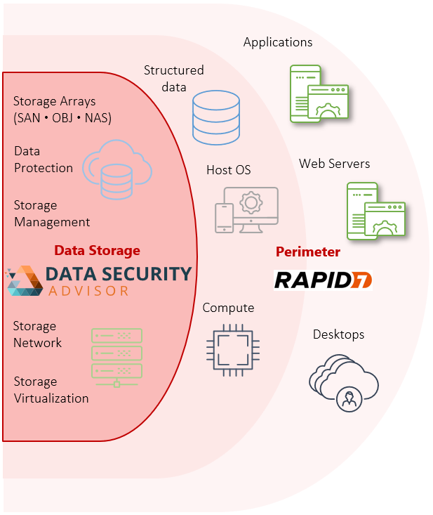
StorageGuard vs Qualys
Markets | Vulnerability Assessment Security Posture Management Data storage security | Vulnerability Assessment Web Application security
Focus Area | Data Storage and Backup | Host and Desktops
Main Scanned Platform Types | Storage OS Storage / Backup Software Network (Storage) | Host / Mobile OS, DBMS Host Software Network (Ethernet)
Coverage for Enterprise Storage | >88% | <9%
Storage Vulnerability Knowledgebase | Up to date / Continuously updated | Poor / Outdated / Rarely updated
Storage Configuration Hardening Checks | >1000 | <100
Configuration Change Tracking | Yes | No
Scan Frequency for Enterprise Storage | User-defined Daily (default) / Every X hours / Weekly / Monthly / User-defined / Ad-hoc | User-defined Typically, infrequent (every X months)
Analysis method | Storage-Aware scan Storage-savvy analysis including review of LUNs, volumes zoning, masking, etc. Specialized Storage vulnerability and configuration hardening analysis Storage access control analysis Storage software analysis Storage CLI / API / Config files | Generic Web / Linux / Network Generic Web App / Linux Vulnerability detection Generic network checks
API | REST, SQL | REST
Policy & Compliance | Yes | Yes
Integration | Yes | Yes

Slide 13
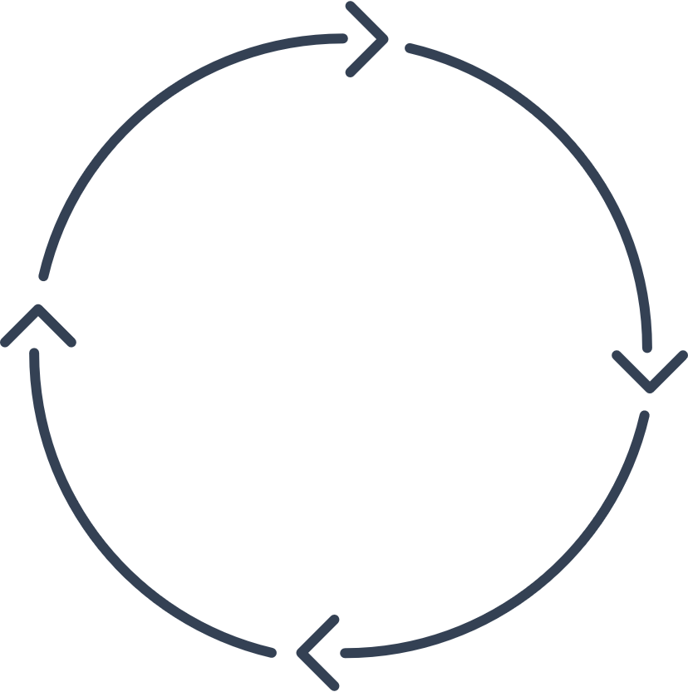
Deployment
Daily collection of configuration from all converged / storage / backup layers
Non-intrusive
Agentless
On-Prem
Collect
Detect
Analyzes configurations using a built-in risk detection engine
Detects security misconfigurations and vulnerabilities
1
2
4
Single-pane-of-glass for ensuring security of storage environment
Automatically reports on successful resolution of issues
Sends actionable alerts to appropriate teams
Suggests remedial steps
Integrates with existing management systems
3
Visualize & track
Prescribe

Slide 14
StorageGuard Support Matrix
SAN Arrays
File Storage & NAS
Storage Virtualization
Dell EMC Symmetrix • VMAX • PowerMAX
Dell EMC XtremIO • PowerStore
Dell EMC VNX • VNX2 • Unity • PowerVault ME
NetApp FAS/AFF • cDOT • 7-mode • filer
Hitachi VSP/USP • AMS • HUS • G-Series
IBM DS • XIV • IBM SVC • V7000/5000 • Storwize • A9000/R • V9000 • FlashSystem • Spectrum Virtualize • Spectrum Accelerate • N-Series
HPE XP • 3PAR* • Primera* • Nimble*
Infinidat InfiniBox
Pure • Huawei*
NetApp FAS/AFF • cDOT • 7-mode
Dell EMC Isilon • PowerScale • VNX/2 • Unity
IBM N-Series • Hitachi NAS* • HPE StoreEasy* • Infinibox • Pure • Huawei*
Dell EMC VPLEX
IBM SAN Volume Controller • Spectrum Virtualize
NetApp FlexArray*
Object Storage
Data Protection
Hitachi Content Platform (HCP)
Dell EMC Elastic Cloud Storage (ECS)
IBM Object Storage* • NetApp StorageGRID*
Dell EMC RecoverPoint • Dell EMC Data Domain • Dell EMC PowerProtect DD • Dell EMC Avamar • IDPA
NetBackup • Commvault • HP StoreOnce • Veeam* • Cohesity • Rubrik • Networker*
IBM Spectrum Protect (Tivoli Storage Manager)*
Dell EMC • IBM • HPE • Hitachi Vantara • NetApp • Infinidat • More.
Storage Management
Storage Network
Brocade directors / switches • OEM versions
Cisco MDS • Nexus • OEM versions
HP VirtualConnect / FlexFabric
Cloud Storage*
Server-based SAN & HCI
Amazon Elastic Block Storage • S3 • Glacier
Azure Blob / Disk Storage
Nasuni • Zadara
NetApp Cloud Volumes ONTAP
Dell EMC PowerFlex (ScaleIO / vxflex OS)*
VMware VSAN*
Nutanix*
Storage Appliance
IBM Spectrum Scale* • Hadoop Appliance*
Oracle ZFS* • Oracle Exadata storage*
(*) roadmap items

Slide 15
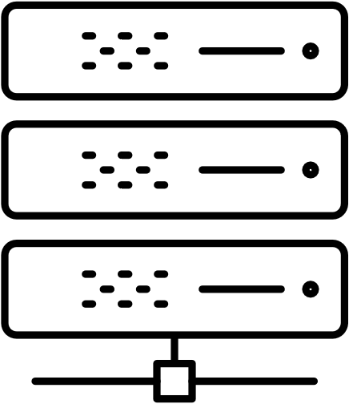
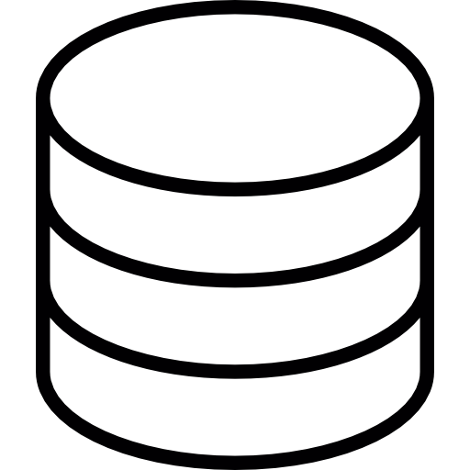
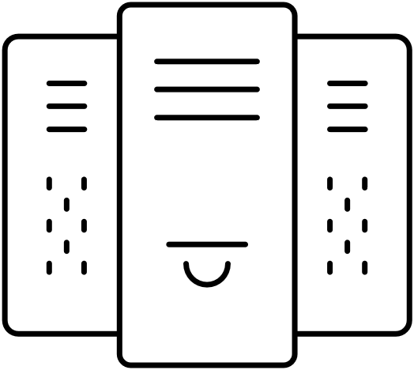
StorageGuard On-Premises Architecture
3
SSH to CLI proxy (VMAX / XIV / 3PAR)
SSH (V7000 / SVC / DataDomain / Isilon / RecoverPoint)
HTTPS (Hitachi / VPLEX)
ZAPI (NetApp)
SSH (EMC/IBM) HTTP (HDS/HP/NETAPP)
1
Master Server:
Windows VM
CS software
Storage arrays
2
4
Cisco MDS CLI
HP vConnect CLI
Brocade CLI
BNA Rest API
12/18/19
SSH / HTTP / Rest
…
3
Scale-out collectors (optional)
3
SAN switches
SSH (Unix)
WMI/WinRM (Windows)
5
Cloud Storage*
OS and vendor commands / queries
All executed commands are strictly read-only
Storage Management Servers
(physical & virtual)

Slide 16
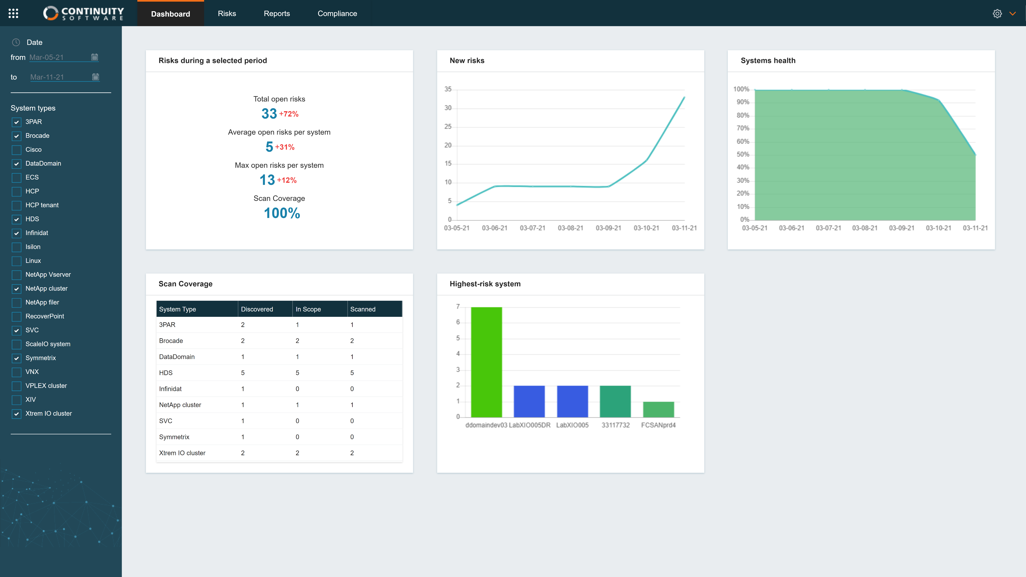

Slide 24
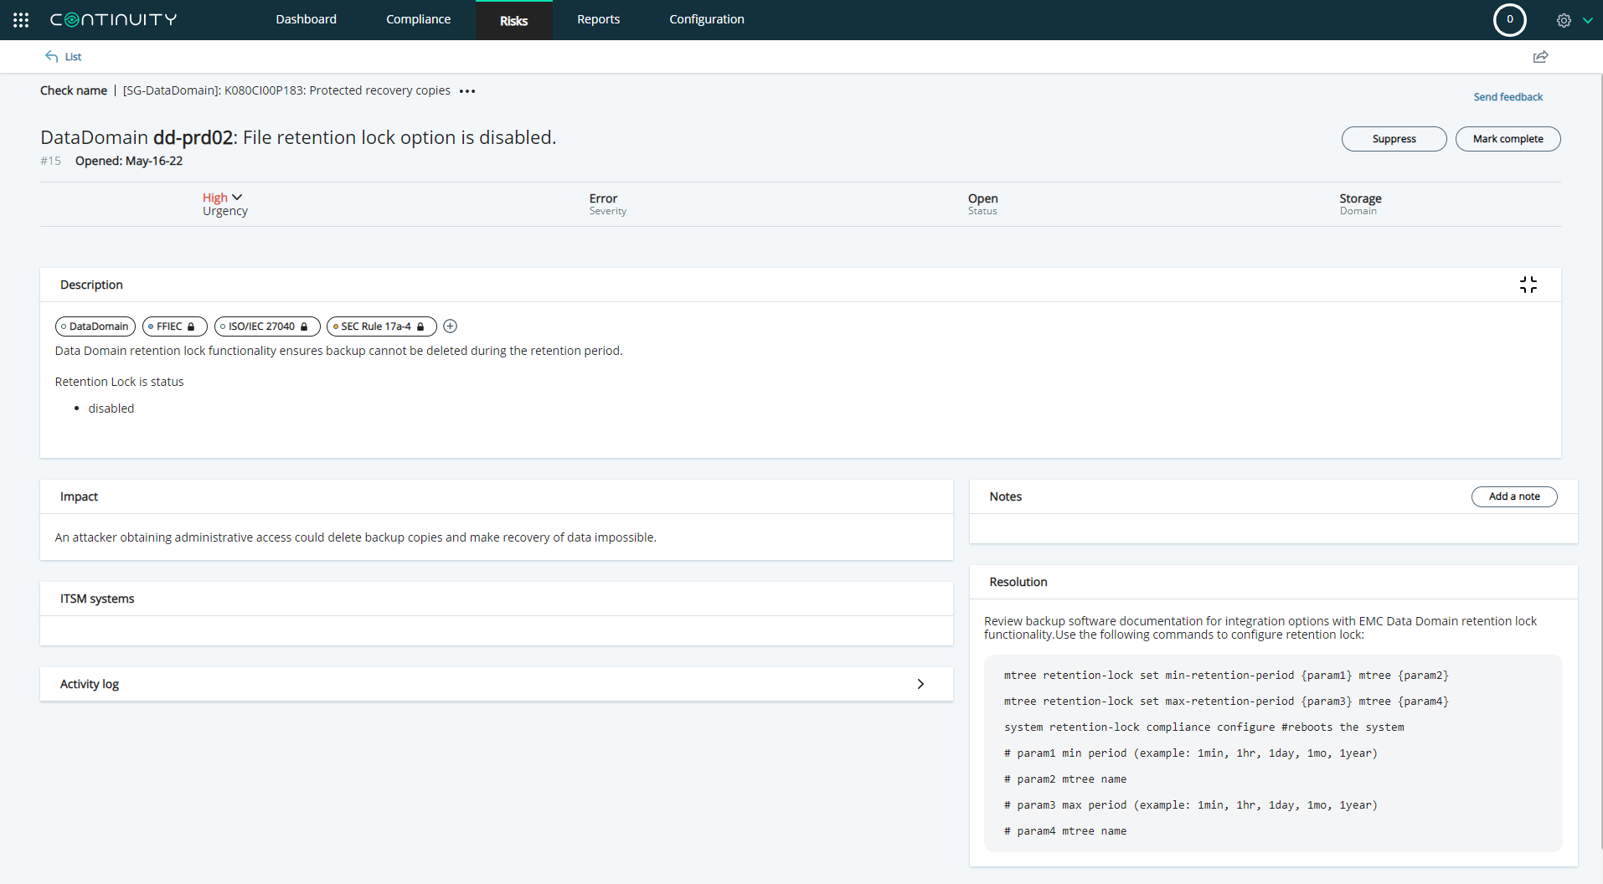

Slide 25
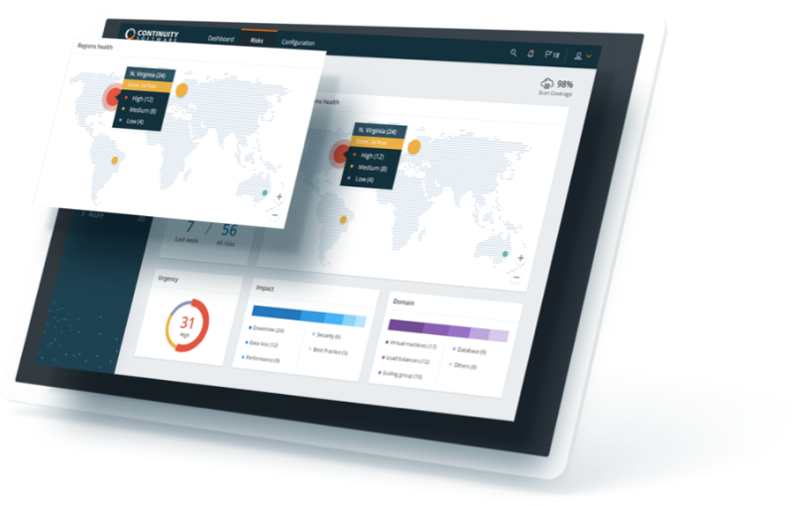
Benefits of using StorageGuard
Ensure storage & backup systems are continuously hardened and can withstand ransomware and other cyber-attacks
Protection & Compliance
Eliminate manual security validation efforts
Obtain valuable remediation guidance to speed-up time to resolve
Meet IT Audit requirements: providing evidence for compliance
Eliminate configuration drift: tracking security configuration changes
Continuously validate against your chosen storage/backup security baseline
Visibility & Prioritization
Ongoing Reporting and dashboarding of remediation status and risk reduction trends
Routinely updated risk knowledgebase
Easily customizable with required additional security checks

Slide 26
StorageGuard POC
Learn how to achieve continuous storage/backup security, by running a StorageGuard POC
A POC covers up to 9 scenarios:
Scan of 3 selected storage/backup systems
Detection of security risks
Remediation guidance
Auto-validation of remediated risks
Security baseline creation
Security baseline reporting and continuous validation
Compliance reporting
Integration and routing options
Custom checks
Details: See StorageGuard POC Plan
Duration: 5 joint work sessions (typically over a 2-week period)
Conclusion: Presentation of POC Summary & Results to Senior Management

Slide 27
StorageGuard License
Continuous automatic scanning of the storage & back environment for security mis-configurations and vulnerabilities
Model – Annual license or multi-year
Annual License includes:
Access to all product updates during the License term
Technical Support
Assigned Customer Success Engineer
Sizing metric – Number of Storage / Backup systems
 | A 'Storage/Backup System' means: | Examples:
1. | Storage array or appliance (block, file, object) | Dell EMC VMAX; NetApp cluster
2. | SAN switch | Brocade switch or director
3. | Each 4 nodes in a CI/HCI cluster | Nutanix cluster, VMware VSAN cluster
4. | Data protection appliance | Dell EMC RecoverPoint
5. | Backup master server | NetBackup master server
6. | Backup media server | NetBackup media server
7. | Backup node | Node in a Rubrik cluster

