Slide 2
“
Ransomware attacks are targeting organizations’ network-attached storage (NAS) and backup storage devices.
”
“
2021 will see a major emphasis in developing more comprehensive storage system security
”

Slide 3
ABOUT US
SELECTED CUSTOMERS
Founded in 2005, helping enterprises with:
Proactively preventing outages and data loss incidents on critical IT
Ensuring the security of data storage systems

Slide 4
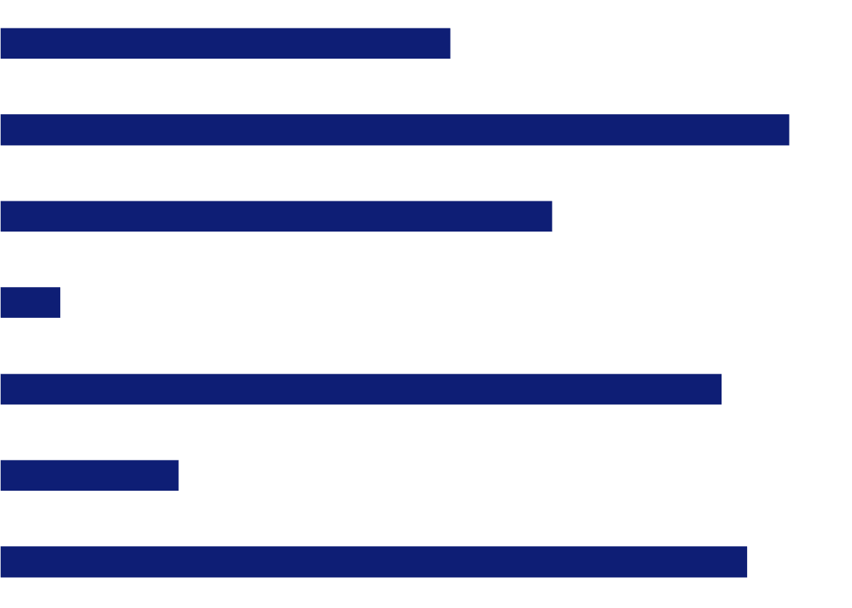
SUCCESS STORY - LEADING BANK
THE CUSTOMER
An American multinational bank and financial services company*
CHALLENGE (CONTINUED)
Manual analysis is not feasible
Failure to meet auditor deadlines for remediating the gap
CHALLENGE
No repeatable and trackable method to assess the security of business-critical data enterprise storage systems
Ransomware concern
SOLUTION BY CONTINUITY SOFTWARE
Continuous scanning and analysis of the bank IT systems worldwide
Overall health and compliance reports
Low 2
Business service
Vulnerability score
Compliance score
Medium 28
KYC
Structured deals
International banking
Automates clearing house
Bank for international settlements…
Payment service
Online Banking
53
39
High 9
93
100
65
22
7
71
85
52
21
96
88
35

Slide 5
RANSOMWARE
New ransomware attacks target your NAS devices
OCIE risk alert:“Misconfigured security settings on a storage device could result in unauthorized access to information”

Slide 6
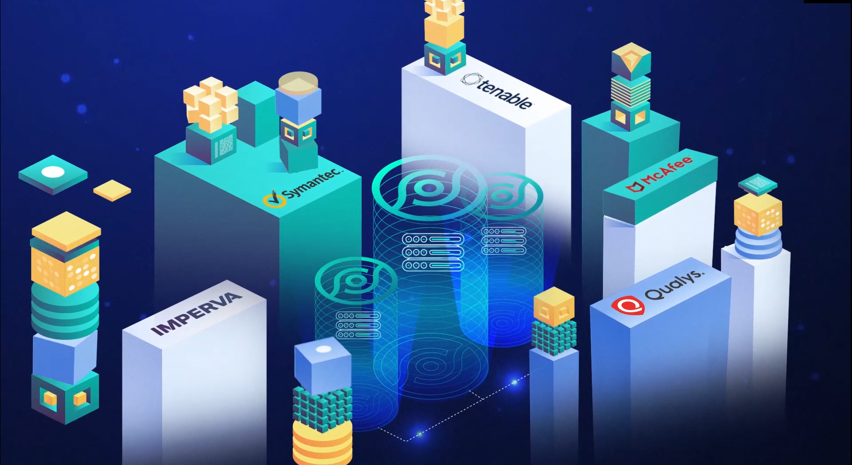
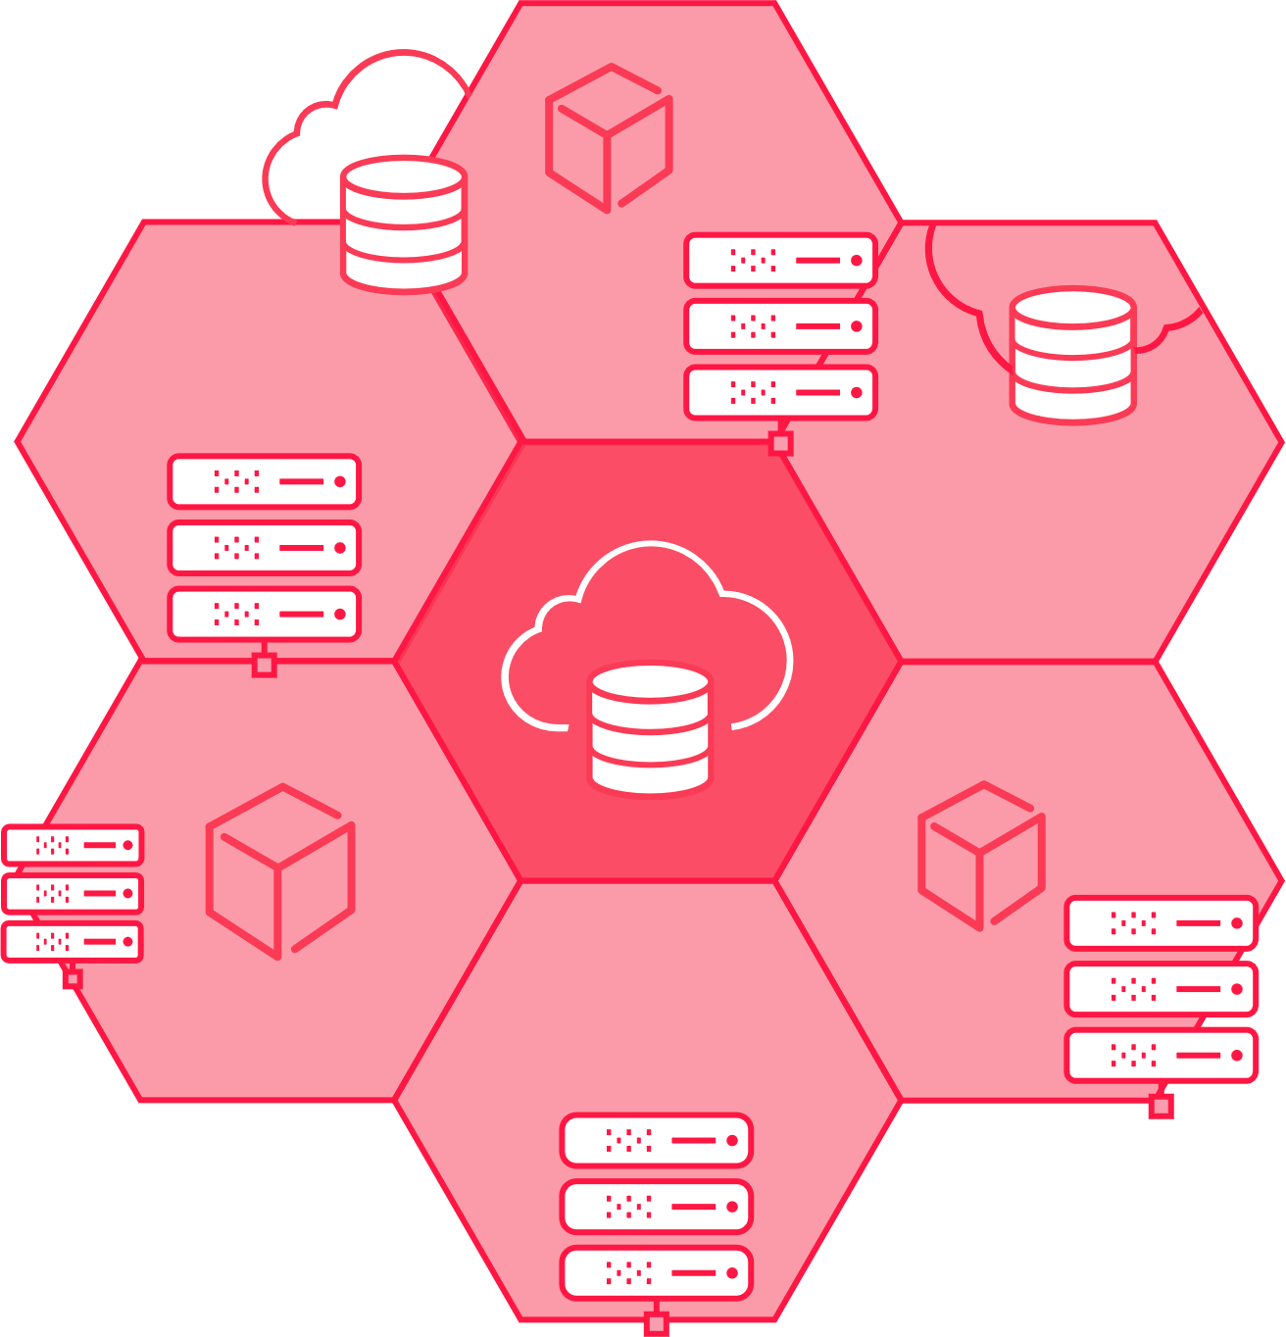
THE UNSPOKEN GAP
“Ransomware attacks are targeting organizations’ network-attached storage (NAS) and backup storage devices.”
A compromised
storage system
will lead to
multi-system failure

Slide 7
FILLING THE UNSPOKEN GAP
“Ransomware attacks are targeting organizations’ network-attached storage (NAS) and backup storage devices.”

Slide 8
6,300
security issues detected
An enterprise storage device has 15 vulnerabilities
Out of 15 vulnerabilities, 3 are high or critical risk

Slide 9
IS IT TIME FOR STORAGE SECURITY
New ransomware attacks target your NAS devices
 | Commonly-held Assumption | Reality
Data | Data is already secured at multiple layers (OS, Database, Network…) | Storage & Backup is where 100% of your data lives!
Attack Surface | Small and deep inside the perimeter/datacenter | Large, vulnerable, and reachable
Threat Level | Most attacks target users, end-points, servers | Number of attacks on storage is small but growing; however, impact can be devastating
Ransomware | Most ransomware encrypts data on end-points/servers; securing storage can't stop that | Storage & Backup is the last line of defense against any ransomware attack -- secure data copies & backups essential for recovery!
Existing Tools | Lots of tools already in place for vulnerability scanning (eg, Rapid7, Nessus, Qualys) | Existing tools offer almost zero coverage for storage, storage management, and backup
OCIE risk alert:“Misconfigured security settings on a storage device could result in unauthorized access to information”

Slide 10
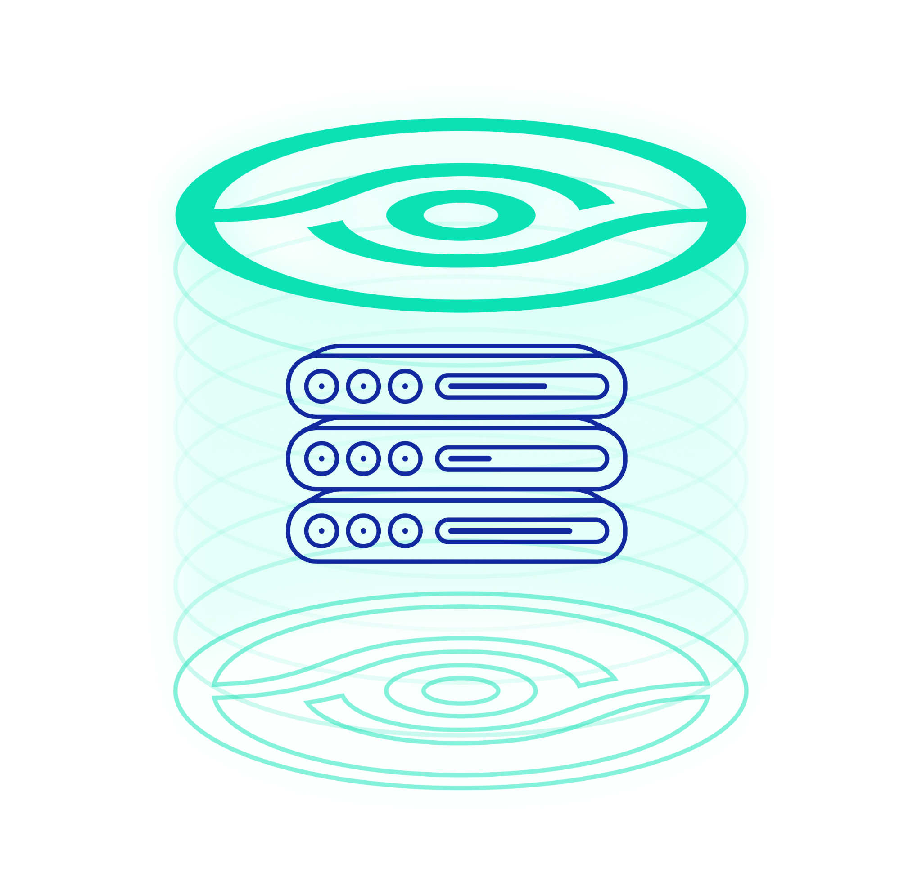
THE SOLUTION - STORAGEGUARD
Validation of security configurations and vulnerability management for storage & backup systems
Built-in risk knowledgebase of security configuration best practices
Vendor best practices, community-driven baseline requirements
Ransomware protection, vulnerabilities and compliance checks
Configuration checks for Administrative Access, Authentication, Authorization, Audit Log, Data access, Services and Protocols, Isolation, ISO27001, CIS, NIST and more.
Focus on converged and storage systems
Block, object, Cloud, IP storage, storage network, data protection systems,
Storage management systems, Virtual SAN, NAS/SAN, File System and more

Slide 11
THE RISK KNOWLEDGEBASE SOURCES
Four main sources, including:
Automatic checks based on standard, interpreted for each device type
Automatic checks for comprehensive and ongoingly updated vendor best practices
Automatic checks for storage system vulnerabilities
Automatic checks for community-driven security baseline configurations
Compliance with Standards
(NIST, CIS, ISO, PCI DSS,
HIPAA, STIG, …)
Vendor Best Practices
(EMC, IBM, HP, Cisco,
Brocade, …)
Common Vulnerabilities
& Exposures (CVE)
Internal Baseline Requirements

Slide 12
THE RISK KNOWLEDGEBASE CATEGORIES
Authentication
AD / LDAP, Vaulting, Radius
Kerberos, MFA
Login & passwd requirements
Authorization
Role configuration
Restricted Admin access
Default accounts / passwords
SAN / NAS
Zoning and masking
CIFS and NFS access
Port config
Vendor best practices
Dell EMC, IBM, HP,
Hitachi
Cisco, Brocade, NetApp Infinidat, Amazon, more.
Block Storage Arrays
Storage Network Switches
Storage Management Applications / Servers
Storage Virtualization Systems
Data Protection Appliances
Object Storage
Storage Area Network (SAN)
Server-based SAN (Virtual SAN)
Network Attached Storage (NAS)
Backup Systems
Cloud storage*
Converged / Blade / Hypervisor*
COVERAGE
Administrative access
Management systems / Apps
CLI /API/SMI-S servers
Automatic logoff, sessions
Encryption
At rest / In transit
Encryption level, FIPS, Hashes
Admin / User access, SSL/TLS
Vulnerabilities
Storage CVE detection
Approved versions
Leading standards
ISO 27001, NIST, CIS SANS
NYDFS, SEC, FFIEC, HIPAA
FIPS, PCI DSS and more.
Audit log
Central Logging
Log Retention
Log Config and Immutability
Services / Protocols
Telnet, FTP, RSH, SSH, Rlogin
NFS, CIFS (SMB)
SNMP, NDMP, SMTP
Ransomware protection
Vendor / industry best practices
Protection policies
And more…
Antivirus settings
Time synchronization
And more…

Slide 13
STORAGEGUARD SUPPORT MATRIX
SAN Arrays
File Storage & NAS
Storage Virtualization
Dell EMC Symmetrix • VMAX • PowerMAX
Dell EMC XtremIO • PowerStore* • IDPA
Dell EMC VNX • VNX2 • Unity
NetApp FAS/AFF • cDOT • 7-mode • filer
Hitachi VSP/USP • AMS • HUS • G-Series
IBM DS • XIV • IBM SVC • V7000/5000 • Storwize • A9000/R • V9000 • FlashSystem • Spectrum Virtualize • Spectrum Accelerate • N-Series
HPE XP • 3PAR • Nimble*
Infinidat InfiniBox
Pure*
NetApp FAS/AFF • cDOT • 7-mode
Dell EMC Isilon • PowerScale • VNX/2 • Unity
IBM N-Series • Hitachi NAS* • HPE StoreEasy* • Infinibox
Dell EMC VPLEX
IBM SAN Volume Controller • Spectrum Virtualize
NetApp FlexArray*
Object Storage
Data Protection
Hitachi Content Platform (HCP)
Dell EMC Elastic Cloud Storage (ECS)
IBM Object Storage* • NetApp StorageGRID*
Dell EMC RecoverPoint • Dell EMC Data Domain • Dell EMC PowerProtect DD • Dell EMC Avamar
NetBackup • Commvault* • HP StoreOnce • Veeam* • Cohesity* • Rubrik*
IBM Spectrum Protect (Tivoli Storage Manager)*
Dell EMC • IBM • HPE • Hitachi Vantara • NetApp • Infinidat • More.
Storage Management
Storage Network
Brocade directors / switches • OEM versions
Cisco MDS • Nexus • OEM versions
HP VirtualConnect / FlexFabric
Cloud Storage*
Server-based SAN & HCI
Amazon Elastic Block Storage • S3 • Glacier
Azure Blob / Disk Storage
Nasuni • Zadara
NetApp Cloud Volumes ONTAP
Dell EMC PowerFlex (ScaleIO / vxflex OS)
VMware VSAN*
Nutanix*
Storage Appliance
IBM Spectrum Scale* • Hadoop Appliance*
Oracle ZFS* • Oracle Exadata storage*
(*) roadmap items

Slide 14
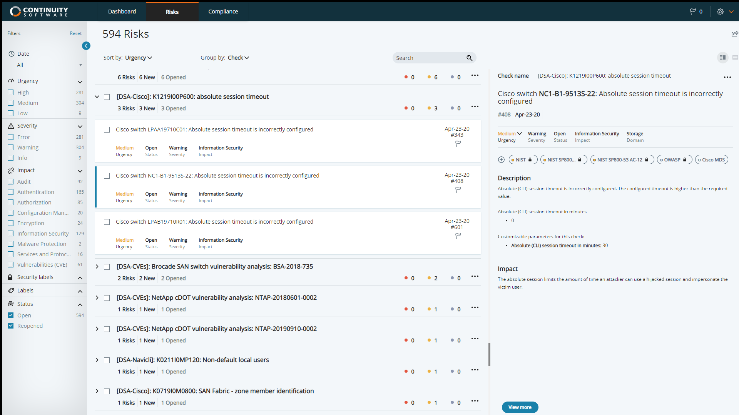

Slide 15
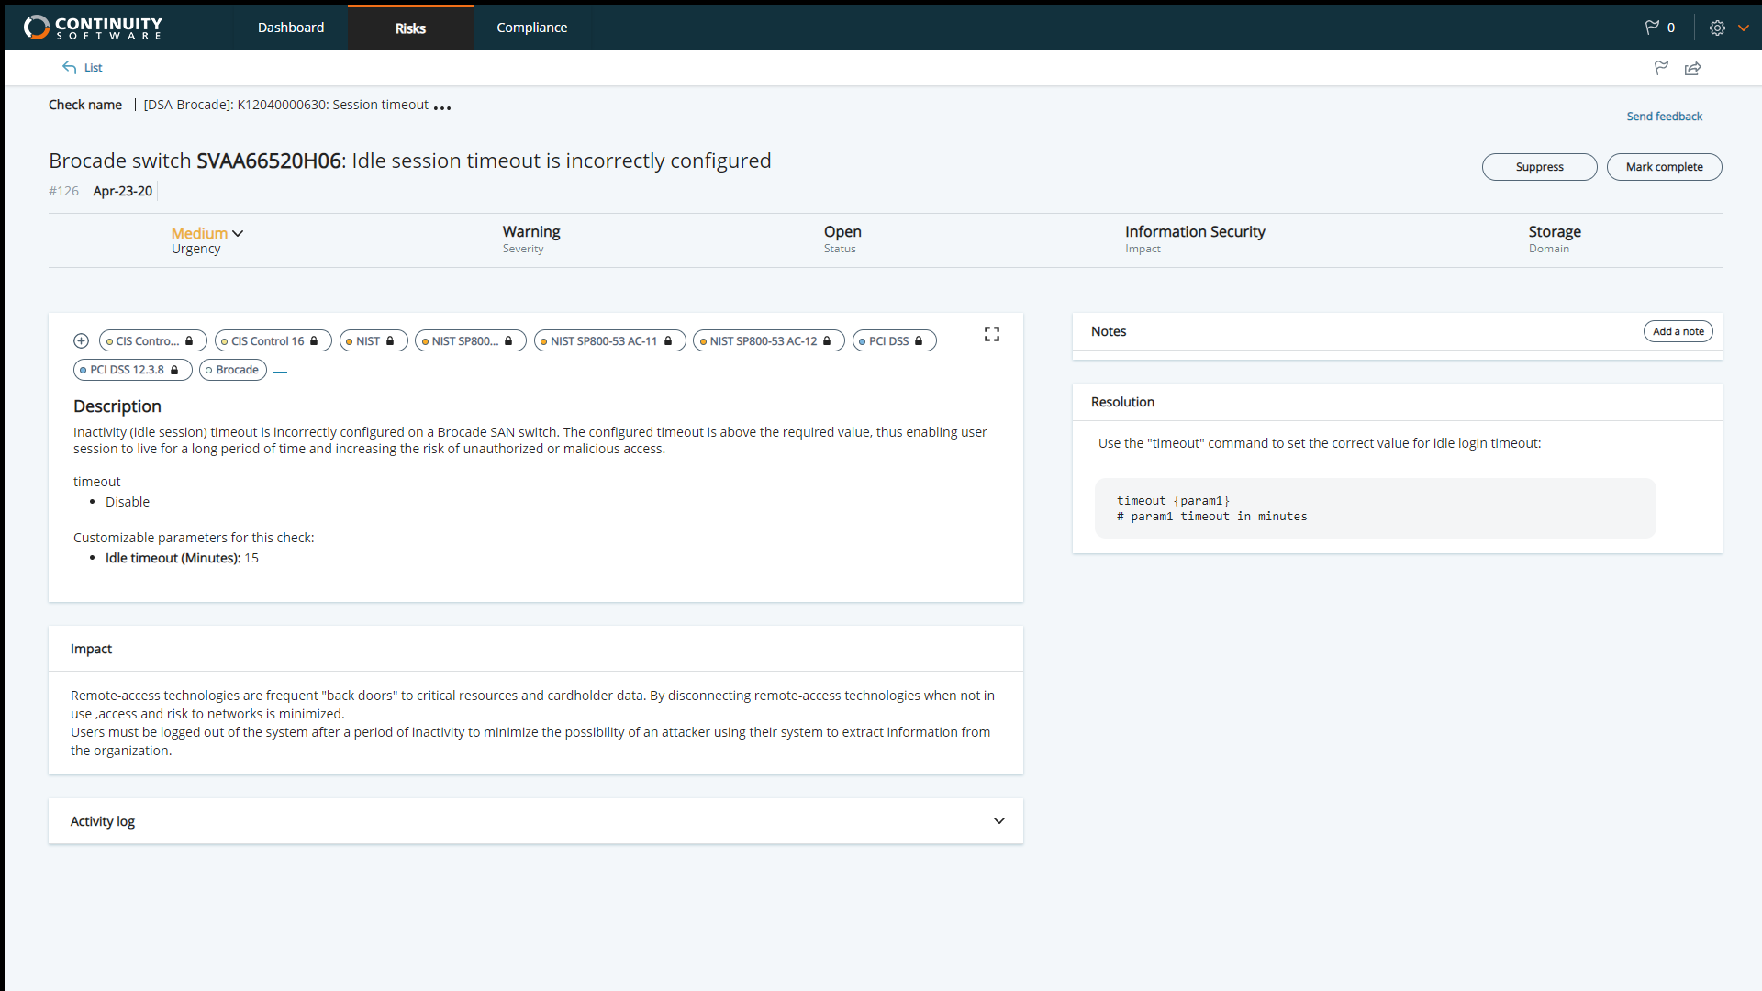

Slide 16
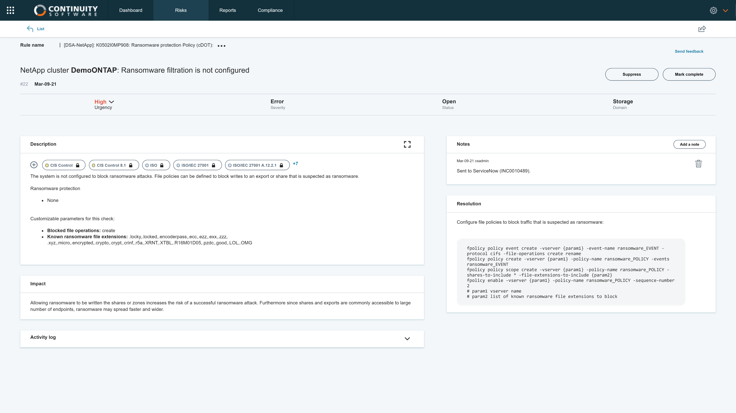

Slide 17
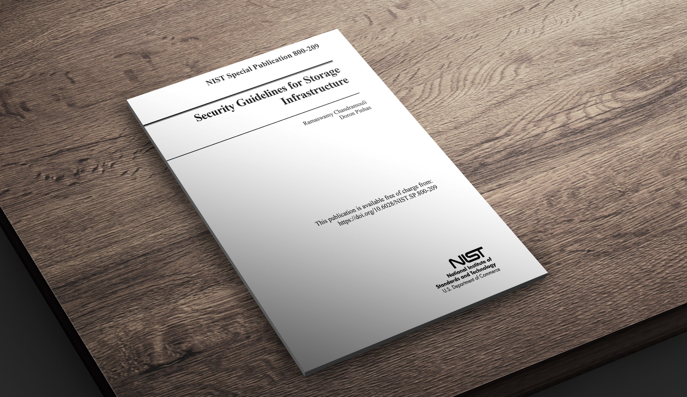
©2021 – Proprietary and Confidential Information of Continuity Software

Slide 18
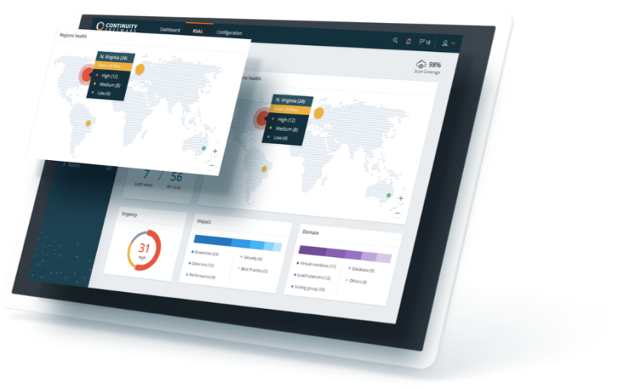
BENEFITS OF USING STORAGEGUARD
Ensure storage systems are hardened and can withstand ransomware and other cyber-attacks
Protection & Compliance
Eliminate manual security validation efforts
Obtain valuable remediation guidance
Meet IT Audit requirements: providing evidence for compliance
Eliminate configuration drift: tracking security configuration changes
Visibility & Prioritization
Reporting and dashboarding of remediation status and risk reduction trends
Routinely updated risk knowledgebase
Easily customizable with required additional security checks

Slide 19
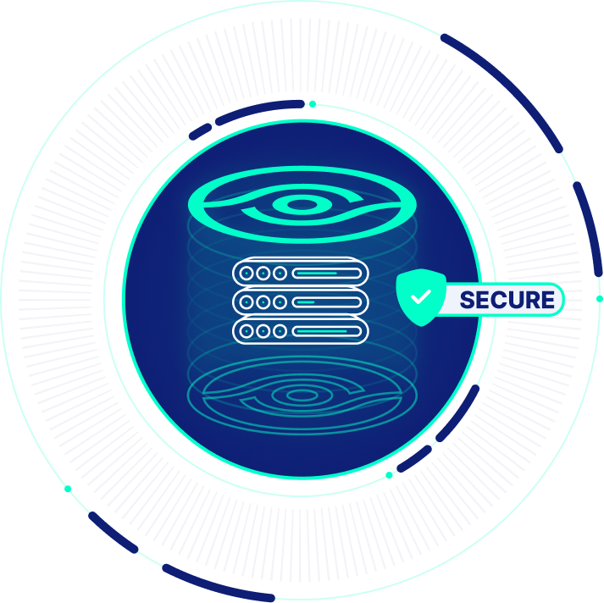
STORAGEGUARD RISK ASSESSMENT
A one-time scan of up to 25 storage systems
Complete and actionable findings report
Performed by Continuity’s Professional Services team
Requires minimal customer effort
Full risk report completed within 1 week

